Slide 1

VEL TECH HIGH TECH DR. RANGARAJAN DR. SAKUNTHALA ENGINEERING COLLEGE An Autonomous Institution
Department of Computer Science and Engineering
Project Review-II
MACHINE LEARNING BASED NUTRIENT RECOMMENDATION SYSTEM FOR SOIL FERTILISATION
SARANYA.S (VH10020)
SRIPONBALA.K(VH10027 )
SARANGAM SAI INDU(VH10019 )
SWATHI.A (VH10031)
IV Year, Computer Science Engineering
Date:02.03.2023
Supervisor
J.S.SOWMIYA B.Tech.,M.E
ASSISTANT PROFESSOR
Computer Science Engineering

Slide 2
CONTENT
Abstract
Introduction
Literature Review
Objectives
Existing System
Proposed System
Implementation model
Methodology
Requirements
Project cost
Workplan
Modules
Result
Output
Future Scope
Conclusion
References

Slide 3
ABSTRACT
Fertilizer use is typically under the limited control of farmers. For the farmers to achieve higher yields and reduce fertilizer loss, competent guidance is required for the best use of these fertilizers. Additionally, there is a connection between rainfall volume and nutrient loss for various fertilizer applications after each rainfall event. Rainfall that is moderate and falls at the right moment can help nutrients penetrate the soil's rooting zone and dissolve dry fertilizer. However, too much rain can increase the possibility of runoff and the pace at which nutrients like nitrogen (N) which is quintessential, phosphorus (P), and potassium (K) which are crucial, manganese (Mn), and boron (B) that are present in the soil. This research presents nutrient recommendations using an updated iteration of the random forest algorithm which is based on time-series data to forecast the required quantity of nutrients for various crops by examining rainfall patterns and crop fertility. The method suggested in this study, comes in handy for improving soil fertility by providing nutrients recommendations for optimum conditions for crop growth and reducing leaching and runoff potential.

Slide 4
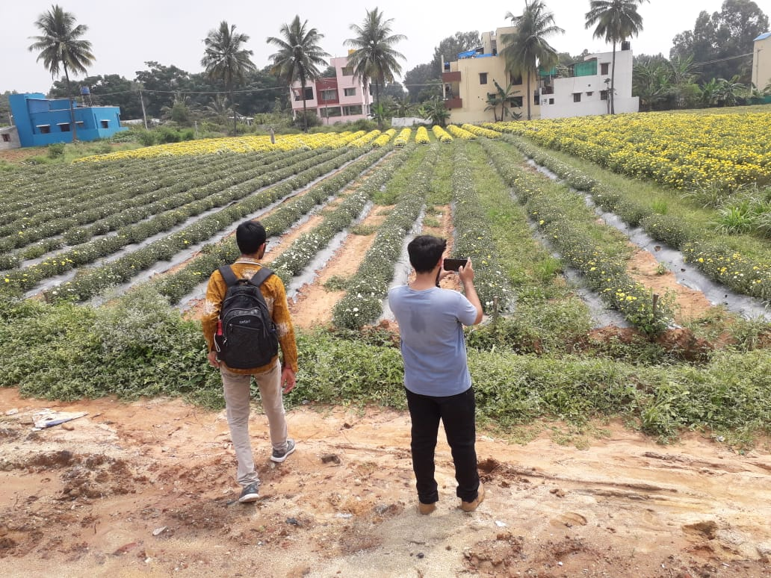
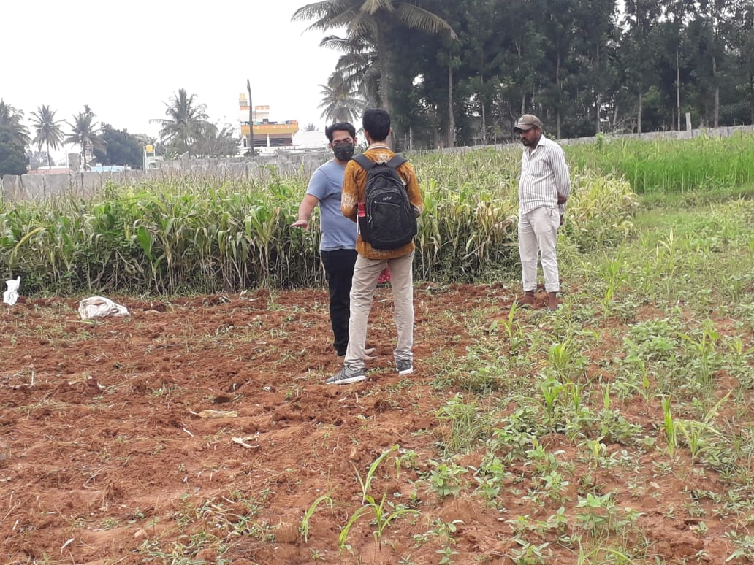
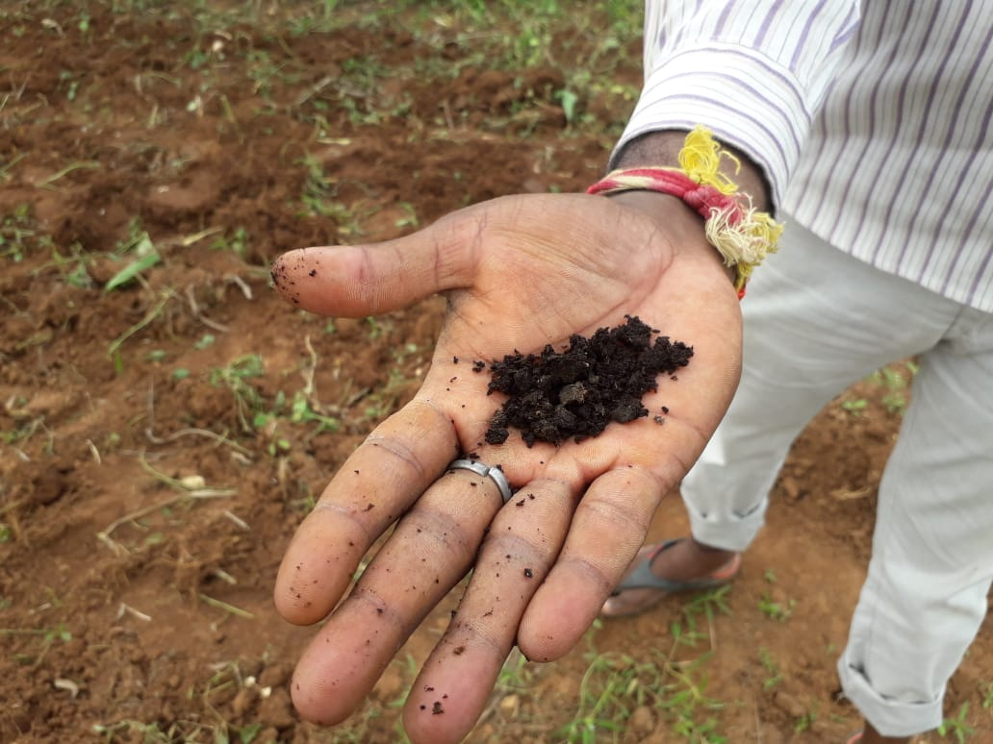

INTRODUCTION
1
Farmers need a competent guidance.
2
Connection between rainfall volume and nutrient loss.
3
The problem statements are analyzed and determined based on what is in our study area.
MACHINE LEARNING BASED NUTRIENT RECOMMENDATION SYSTEM FOR SOIL FERTILISATION

Slide 5
LITERATURE REVIEW
S.NO | TITLE | AUTHOR | YEAR | SOFTWARE/HARDWARE | METHODOLOGY | KEYPOINTS | INFERENCE
1. | Improving the prediction accuracy of soil nutrient classification by optimizing extreme learning machine parameters . | M.S. Suchithra, Maya L. Pai | 2022 | Google Colab | The main objective of this work is to classify area wise soil fertility indices based on the village level soil fertility information, which can be used in making a village wise soil fertility index analysis report. | It predicts the fertility index and ph level of soil and mainly focused on kerala region. | This paper suggests solutions to the classification problems of soil nutrient which are solved using the fast learning classification technique known as Extreme Learning Machine (ELM) with different activation functions.
2. | Smart farming using Machine Learning and Deep Learning techniques . | Senthil Kumar Swami Durai, Mary Divya Shamili | 2022 | Pycharm, Jupter notebook | Four modules proposed in this work such as crop recommendation, weed identification, Pesticide recommendation, crop cost estimation. The proposed work is a Web application developed through Django framework. | Crop recommendation achieves an accuracy of 91% . | The purpose of this paper is to help an individual farm be efficient and thus achieve high yield at a low cost. It also helps to predict the total costs required for growth. It will help one to plan ahead Pre-cultivation activities lead to an integrated solution in agriculture.
3. | Agricultural decision system based on advanced machine learning models for yield prediction: Case of East African countries . | Rubby Aworka, Lontsi Saadio Cedric, Wilfried Yves Hamilton Adoni, Jérémie Thouakesseh Zoueu, Franck Kalala Mutombo, Charles Lebon Mberi Kimpolo, Tarik Nahhal, Moez Krichen . | 2022 | Jupyter Notebook | Proposed three non-parametric models for our predictive analysisof crop yield. Two of the models are tree ensembles: Crop Random Forest(CRF) and Crop Gradient Boosting Machine (CGBM). The other modelis linear, which is Crop Support Vector Machine (CSVM). | Predict an annual crop yieldat the country-level of four crops in fourteen East African countries | Crop Random Forest, Crop Gradient Boosting Machine, and Crop Support Vector Machine are three crop prediction models proposed in this paper. The paper makes use of advanced machine learning models to develop a decision system based on climate data, crop production data, and pesticide data.
MACHINE LEARNING BASED NUTRIENT RECOMMENDATION SYSTEM FOR SOIL FERTILISATION

Slide 6
LITERATURE REVIEW
S.NO | TITLE | AUTHOR | YEAR | SOFTWARE/HARDWARE | METHODOLOGY | KEYPOINTS | INFERENCE
4 | Untangling the effect of soil quality on rice productivity under a 16-years long-term fertilizer experiment using conditional random forest | Saheed Garnaik, Prasanna Kumar Samant, Mitali Mandal, Tushar Ranjan Mohanty, Sanat Kumar Dwibedi, Ranjan Kumar Patra, Kiran Kumar Mohapatra, R.H. Wanjari, Debadatta Sethi, Dipaka Ranjan Sena, Tek Bahadur Sapkota, Jagmohan Nayak, Sridhar Patra, Chiter Mal Parihar, Hari Sankar Nayak. | 2022 | Google colab | Evaluate the changes in soil physical, chemical, and biological properties under long-term fertilizer application and establish cause and effect relationship between soil properties and rice productivity using interpretable machine learning. | It is mainly concentrated on eastern coast of india. | The study demonstrated how interpretable machine learning techniques can be used in long-term fertilizer experiments to produce the most meaningful information, and that these techniques can be used in other similar long-term experiments.
5 | Farmer risk preference and fertilizer use | Fang-binQIAOJi-kunHUANG | 2021 | Bio Labs are needed | The degree of risk aversion can have a negative impact on the amount of fertilizer applied. | Focus on fertilizer use in cotton production in China. | This study examines the role of farmers' risk attitudes toward fertilizer use in cotton production.
6 | Precision agriculture using IoT data analytics and machine learning | Raves Akhtar, Shabbir Ahmad Sofi | 2021 | Jupyter notebook | Used the real time data of wireless sensor/IoT nodes as input for linear regression model. User friendly application is developed for farmers to inform about the status of apple orchards. | The main aim of this study was to predict the apple scab that is the most common disease of apple crop. | This paper proposes an apple disease prediction model in apple orchards in Kashmir Valley using data analysis and machine learning in an IoT system. The paper discusses the challenges faced when integrating these technologies into traditional agricultural approaches.
MACHINE LEARNING BASED NUTRIENT RECOMMENDATION SYSTEM FOR SOIL FERTILISATION

Slide 7
LITERATURE REVIEW
S.NO | TITLE | AUTHOR | YEAR | SOFTWARE/HARDWARE | METHODOLOGY | KEYPOINTS | INFERENCE-52\-
7. | Crop yield prediction using machine learning. | Thomas van Klompenburga , Ayalew Kassahuna , Cagatay Catal | 2021 | Web browsers. | This paper includes the systematic Research analysis. | Artificial Neural Networks (ANN) is the most used algorithm for crop yield prediction. | Comprehensive method developed to estimate crop sustainability using supervised algorithms that increase crop yields, reduce manual labor, time spent on various agricultural activities and plant recommendations based on certain soil parameters.
8. | Prediction of the production of crops with respect to rainfall.. | Benny Antony | 2021 | Google colab | The regression techniques are evaluated based on their Mean Squared Error . | This paper predicts the production of crops as a function of rainfall for four Indian States for two crops(rice, wheat). | This paper predicts the production of crops as a function of rainfall. This is implemented by generating a rough overview of how the production is based on rainfall and how much can a specific crop production for the amount of rainfall it receives. The proposed method of evaluation is better than other existing methods of evaluation as it evaluates all the regression techniques..
9. | Analysis of agricultural crop yield prediction using statistical techniques of machine learning | Janmejay Pant, R.P. Pant, Manoj Kumar Singh, Devesh Pratap Singh, Himanshu Pant | 2021 | Jupyter notebook, pycharm | This paper used four machine learning algorithms to train the model selected the most accurate crop prediction | Determine the response of crops towards the factors which are responsible for good crop production. | This paper suggests the use of Machine Learning techniques to create a trained model for detecting patterns in data, which we then used to predict crop yields. The application of machine learning to the prediction of four of India's most cultivated yields is considered in this study. Maize, potatoes, rice (paddy), and wheat are among these crops.
MACHINE LEARNING BASED NUTRIENT RECOMMENDATION SYSTEM FOR SOIL FERTILISATION

Slide 8
LITERATURE REVIEW
S.NO | TITLE | AUTHOR | YEAR | SOFTWARE/HARDWARE | METHODOLOGY | KEYPOINTS | INFERENCE
10. | Optimized fertilizer recommendation method for nitrate residue control in a wheat–maize double cropping system in dryland farming . | Zujiao Shi, Donghua Liu, Miao Liu, Muhammad Bilal Hafeez, Pengfei Wen, Xiaoli Wang, Rui Wang, Xudong Zhang, Jun Li | 2021 | Experimental crop land, MATLAB | The optimized fertilizer recommendation method based on SNC, the target yield, and NR is convenient for determining the appropriate amounts of N fertilizer for application in the winter wheat–summer maize double cropping system. | The target yield and NR were generally relatively stable for winter wheat and summer maize when the other production conditions did not change significantly in a specific area. | To optimize the fertilizer recommendation method and reduce nitrate residue levels, this paper establishes the relationships between crop yield, nitrogen requirement, and nitrate residue level under combined N and P fertilizer application.
11. | Crop yield forecasting using Data Mining | Pallavi Kamath , Pallavi Patil , Shrilatha S , Sushma , Sowmya S | 2021 | Pycharm | Random Forest used to forecast the yield of major crops based on historical data. | It yield the accuracy of 92%. | By studying the soil and atmosphere for the specific area, by which increase crop production, optimal crop can be estimated.
12. | Controlled traffic farming effects on productivity of grain sorghum, rainfall and fertiliser nitrogen use efficiency. | A.Hussein Diogenes L. Antille Shreevatsa Kodur GuangnanChen Jeff N.Tullberg | 2021 | MATLAB | The experiment was conducted in two adjacent blocks; namely: CTF and non-CTF . | The overall fertiliser type effect on yield and NUE was small relative to that of traffic . | Enhanced efficiency fertilizers cannot compensate for other stresses caused by compaction.
MACHINE LEARNING BASED NUTRIENT RECOMMENDATION SYSTEM FOR SOIL FERTILISATION

Slide 9
LITERATURE REVIEW
S.NO | TITLE | AUTHOR | YEAR | SOFTWARE/HARDWARE | METHODOLOGY | KEYPOINTS | INFERENCE
13. | A nutrient recommendation system for soil fertilization based on Evolutionary Computation. | Usman Ahmed Jerry Chun-Wei Lin Gautam Srivastava Youcef Djenouri. | 2021 | Google colab | This paper proposes nutrient recommendations through an improved genetic algorithm (IGA) that uses time-series sensor data . | The proposed model can perform better for cotton and groundnuts. | This paper develops a model that enables efficient exploration of correct usage of nutrients (such as N, P and K) for developing a knowledge-based system for the ICT (Information and Communication Technology) environment.
14. | Would fertilization history render the soil microbial communities and their activities more resistant to rainfall fluctuations? | János Kátai Ágnes Oláh Zsuposné Magdolna Tállai Tarek Alshaal | 2020 | Bio Lab | ANOVA test, Levene's Test for Equality of Variances is performed. | High rates of NPK significantly reduced soil dehydrogenase activity. | This paper aims to study the intrinsic changes in the composition of soil populations and their functions due to the interaction between long-term fertilization and rainfall fluctuations, seeing whether fertilization history would render the soil microbial communities and their activities more resistant to water stress or not..
15. | Cropping systems in agriculture and their impact on soil health | TonyYang, Kadambot H.M. Siddique, Kui Liu | 2020 | Experimental crop land and chemical laboratory is needed. | Refine content of soil health and the development of new evaluation standards for ‘soil health and quality’ by combining various soil health indicators into indices in agroecosystems, | This paper reviews the impact of conventional cropping systems on soil health, microbiological indicators. | Significant achievements, including refine content of soil health and the development of new evaluation standards for ‘soil health and quality’.
MACHINE LEARNING BASED NUTRIENT RECOMMENDATION SYSTEM FOR SOIL FERTILISATION

Slide 10
LITERATURE REVIEW
S.NO | TITLE | AUTHOR | YEAR | SOFTWARE/HARDWARE | METHODOLOGY | KEYPOINTS | INFERENCE
16. | Crop Yield Prediction Based on Indian Agriculture using Machine Learning. | Potnuru Sai Nishant Pinapa Sai Venkat Bollu Lakshmi Avinash B. Jabber | 2020 | Google colab | The paper uses advanced regression techniques like Kernel ridge, Lasso and Enet algorithms. | Concept of stacked regression is used to improvise the model. | This paper predicts the yield of almost all kinds of crops in India. This script makes novel by usage of simple parameters like state, district, season, area and the user can predict the yield of the crop in which year he or she wants to.
17. | Rainfall intensification increases nitrate leaching from tilled but not no-till cropping systems in the U.S. Midwest | Laura J.T. Hess Eve-Lyn S. Hinckley G. Philip Robertson Pamela A. Matson | 2020 | MATLAB | Linear mixed models with a nested design used to determine the effects of rainfall intensification and tillage on soil water N conc. | Variation in soil type,structure influence cropping system respond to rainfall intensification. | Rainfall intensification may exacerbate leaching losses of reactive N from cropping systems, and that no-till management may buffer against these losses.
18. | Estimation of NPK requirements for rice production in diverse Chinese environments under optimal fertilization rates | Yulong Yin, Hao Ying Huifang Zheng ,Qingsong Zhang ,Yanfang Xue, Zhenling Cui | 2019 | Chemical laboratory is needed. | Plant samples are oven dried and then milled and digested with concentrated H2SO4 and H2O2. | Estimate rice nutrient requirements. | Objectives of this study were to evaluate the relationship between nutrient requirements and climates or soil chemical properties.
MACHINE LEARNING BASED NUTRIENT RECOMMENDATION SYSTEM FOR SOIL FERTILISATION

Slide 11
LITERATURE REVIEW
S.NO | TITLE | AUTHOR | YEAR | SOFTWARE/HARDWARE | METHODOLOGY | KEYPOINTS | INFERENCE
19. | Fuzzy decision support system for improving the crop productivity and efficient use of fertilizers | G. Prabakaran,D. Vaithiyanathan, Madhavi Ganesan | 2019 | MATLAB | The fuzzy logic system developed in this research as part of the Decision Support System, concentrates on maximizing crop productivity while minimizing fertilizer usage. | Establish feasibility rules for decision support systems for the crops. | This paper explores the process of using fuzzy logic systems to reduce fertilizer consumption and improve crop productivity.
20. | Prediction of Crop Fertilizer Consumption | Krutika Hampannavar, Vijay Bhajantri Shashikumar G. Totad | 2019 | Jupyter notebook | The system consists of phases such as: Image acquisition, converting of input image to gray scale image, plotting of histogram, segregating plants into healthy and nitrogen deficient plants determining the affected region and fertilizer consumption. | The identification of nutrient deficiency is helpful to farmer for proper monitoring of crop growth and optimum usage of fertilizers. | Prediction of fertilizer consumption can prevent the toxicity and deficiency in plants to certain extent and this can help farmers to get proper yield without much wastage.
MACHINE LEARNING BASED NUTRIENT RECOMMENDATION SYSTEM FOR SOIL FERTILISATION

Slide 12

OBJECTIVES
1
To provide useful information for fertilizer use in terms of nutrients (NPK) by considering weather forecasts.
2
To reduce water pollution by slowing down the process of leaching.
MACHINE LEARNING BASED NUTRIENT RECOMMENDATION SYSTEM FOR SOIL FERTILISATION

Slide 13

EXISTING SYSTEM
Existing system doesn’t account for rainfall patterns and eventually fails to prevent leaching.
The system only works for few crops and few places and also their accuracy is low.
The smart farming system is not quite affordable eventhough it is reliable.
MACHINE LEARNING BASED NUTRIENT RECOMMENDATION SYSTEM FOR SOIL FERTILISATION

Slide 14

PROPOSED SYSTEM
The proposed system provides a helping hand to our farmers using a predictive model by random forest algorithm.
Random forest regression with k-fold cross-validation technique represents the model with acceptable accuracy for prediction.
It gives information about the quantity of nutrients required by the crops using a predictive model.
It provides weather alerts and messages. Alerts are displayed in the output of this application in case of bad weather conditions.
Seven-day weather forecasts to timely plan the fertilization.
MACHINE LEARNING BASED NUTRIENT RECOMMENDATION SYSTEM FOR SOIL FERTILISATION

Slide 15
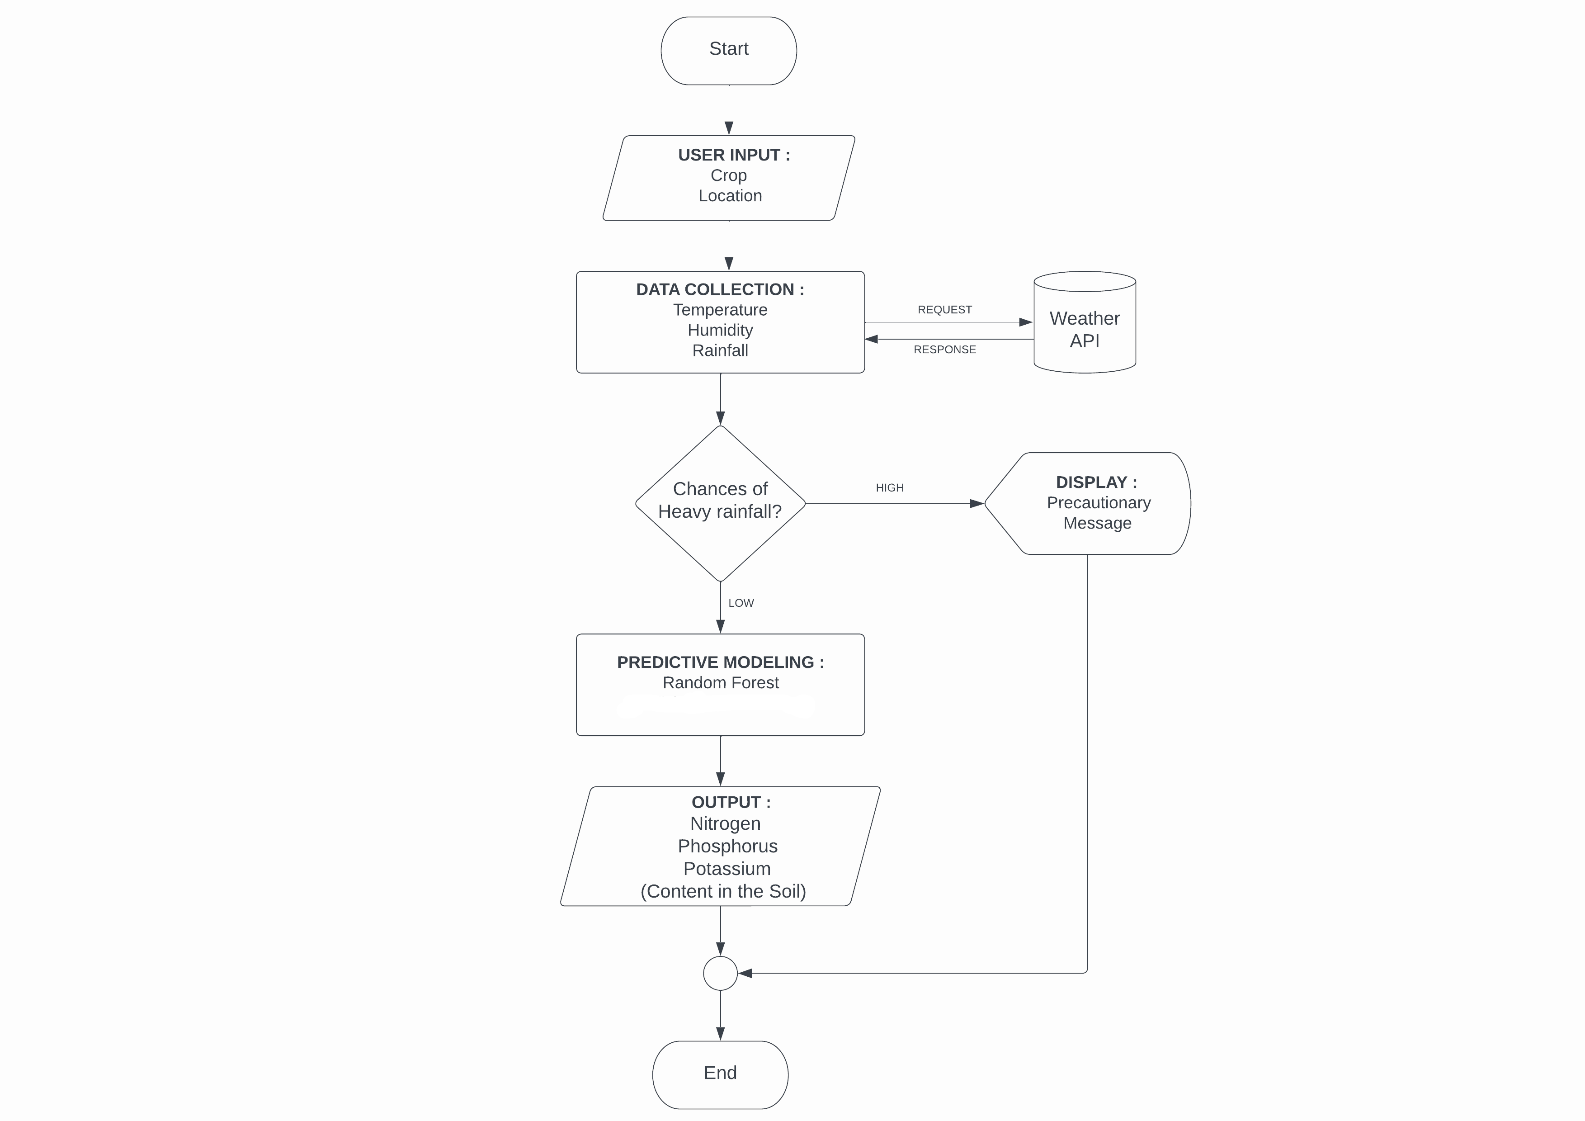
IMPLEMENTATION MODEL
Flowchart :
MACHINE LEARNING BASED NUTRIENT RECOMMENDATION SYSTEM FOR SOIL FERTILISATION

Slide 16
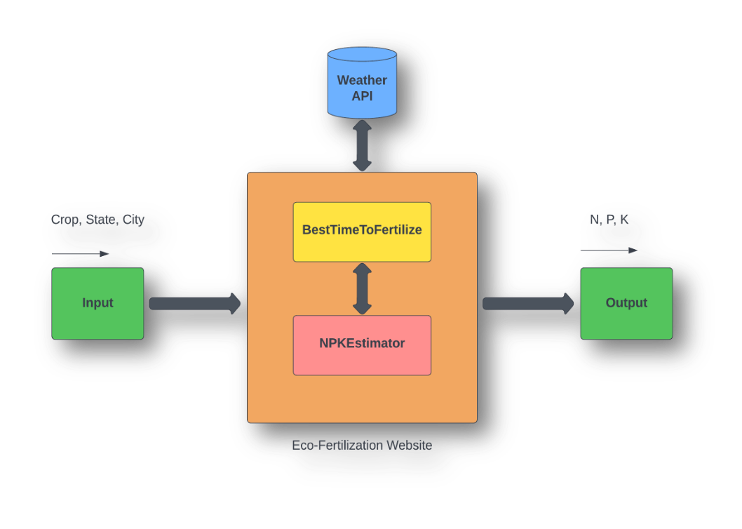
IMPLEMENTATION MODEL
BLOCK DIAGRAM :
System architecture is a conceptual model that defines the structure and behavior of the system. It comprises of the system components and the relationships describing how they work together to implement the overall system. The Figure shows the system’s architecture and the various components added to them.
The description of each component from the block diagram and their major functionalities with respect to the Eco-Fertilization as a complete unit is described in the table below.
S. no. | Block Name | Functions
1 | Input | User provides data such as crop , state and city using drop down menu
2 | Weather API | Weather details like temperature, rainfall etc is fetched from the weather API
3 | BestTimeToFertilize | This module provides the functionality to determine the best time to fertilize using fetched weather data and provides warming for heavy rain.
4 | NPKEstimator | This module estimates the required ratio of NPK contents in the soil.
5 | Output | Nitrogen, Phosphorus and Potassium content displayed on the website
MACHINE LEARNING BASED NUTRIENT RECOMMENDATION SYSTEM FOR SOIL FERTILISATION

Slide 17
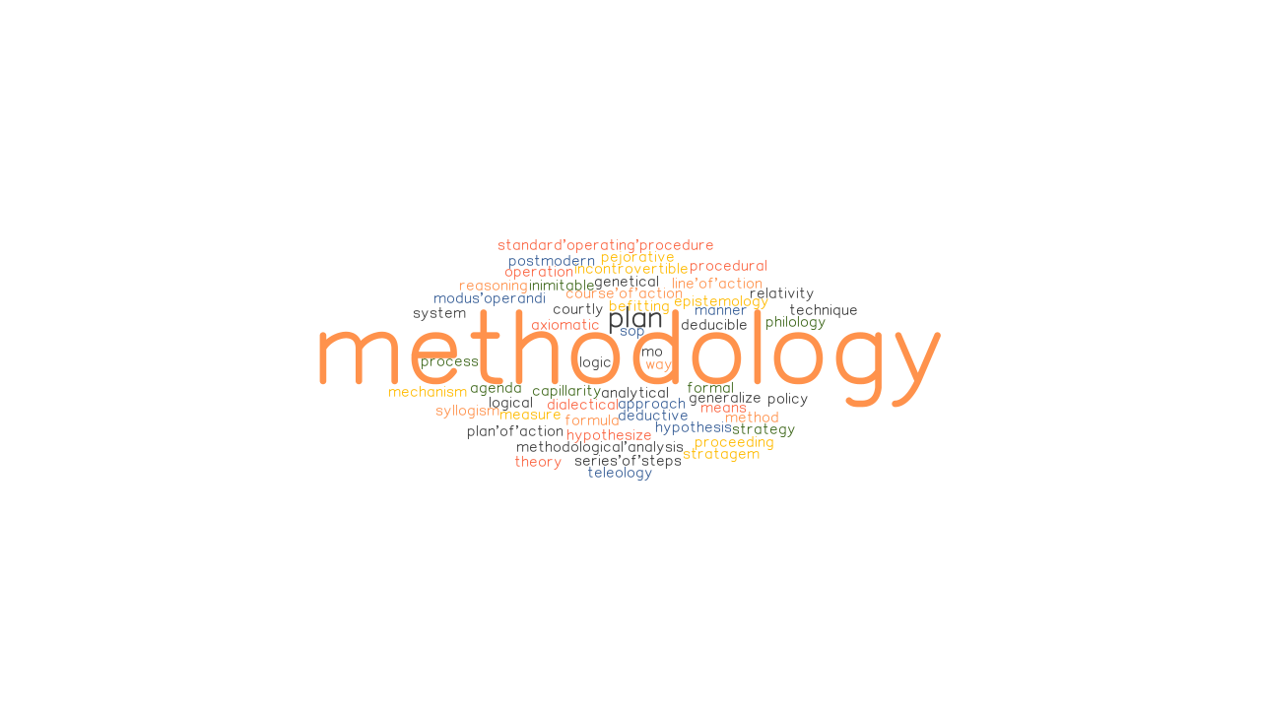
METHODOLOGY
In this study, a predictive model for the nutrients required for crops was obtained using Machine learning algorithms.
The algorithm requires input from the user (such as location and cropping). The location is fed to the Weather API which will return certain characteristics (e.g. temperature, humidity, rainfall) and if there is a possibility of heavy rainfall, a precautionary message is displayed to the user, otherwise the proposed algorithm is followed.
MACHINE LEARNING BASED NUTRIENT RECOMMENDATION SYSTEM FOR SOIL FERTILISATION

Slide 18

REQUIREMENTS
Tools & Technologies :
Jupyter Notebook
Python
Matplotlib
HTML / CSS
Flask
VS Code
MACHINE LEARNING BASED NUTRIENT RECOMMENDATION SYSTEM FOR SOIL FERTILISATION

Slide 19
PROJECT COST/BUDGET
S.NO | ACTIVITY | AMOUNT
1. | Jupyter Notebook (open source) | NIL
2. | Python – 3.11.1 (open source) | NIL
3. | Flask (open source) | NIL
4. | Visual studio code (open source) | NIL
MACHINE LEARNING BASED NUTRIENT RECOMMENDATION SYSTEM FOR SOIL FERTILISATION

Slide 20
WORK PLAN
Period | Activity
February 1st week | Ideation phase(Title identification,Literature survey,Defining problem statement,Methodology,Block diagram)
February 2nd -3rd week | Dataset collection and analysis
February 4th week – March 1st week | Project Development phase – I(coding and module implementation)
March 2nd – 3rd week | Project Development phase – II(Overall implementation and testing)
March 4th week | Documentation and journal paper draft
MACHINE LEARNING BASED NUTRIENT RECOMMENDATION SYSTEM FOR SOIL FERTILISATION

Slide 21
MODULES
List Of Modules:
Modules | Description
MODULE 1 | Data collection and Preparation
MODULE 2 | Building an Machine Learning Model
MODULE 3 | Build an Web application using flask
MACHINE LEARNING BASED NUTRIENT RECOMMENDATION SYSTEM FOR SOIL FERTILISATION

Slide 22
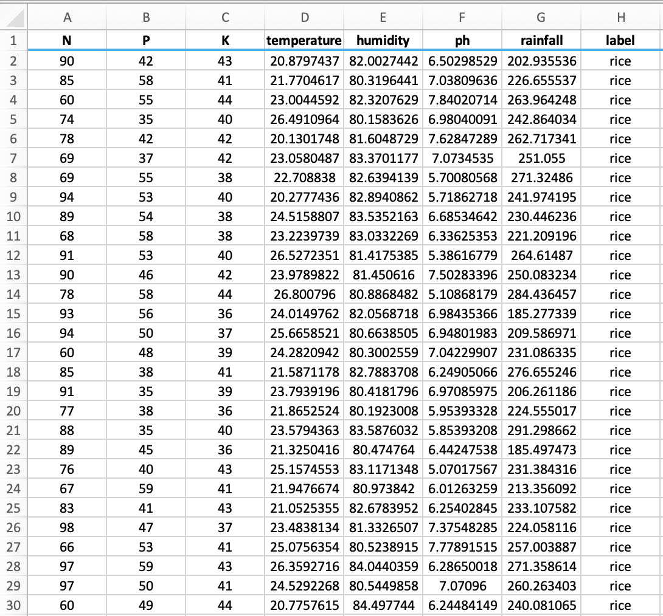
MODULE 1 :Data Preparation
Actual Dataset :
MACHINE LEARNING BASED NUTRIENT RECOMMENDATION SYSTEM FOR SOIL FERTILISATION

Slide 23
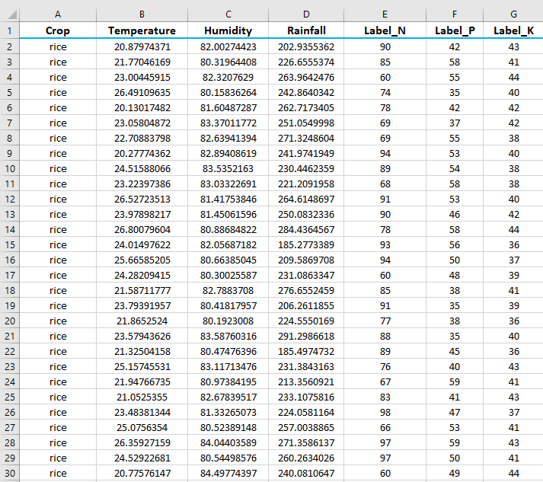
MODULE 1 :Data Preparation
Customised Dataset :
Actual Dataset contains 8 features. All of the features are not useful for proposed model. Therefore, a dimension reduction technique called feature selection is applied and seven features, then selected for evaluation.
MACHINE LEARNING BASED NUTRIENT RECOMMENDATION SYSTEM FOR SOIL FERTILISATION

Slide 24
MODULE 1 :Data Preparation
Data Description :
Input Features :
Crop : rice, cotton, etc.
Temperature : temperature in degree Celsius
Humidity : relative humidity in percentage
Rainfall : rainfall in mm
Output Features :
Label_N : ratio of Nitrogen content in soil.
Label_P : ratio of Phosphorous content in soil.
Label_K : ratio of Potassium content in soil.
MACHINE LEARNING BASED NUTRIENT RECOMMENDATION SYSTEM FOR SOIL FERTILISATION

Slide 25
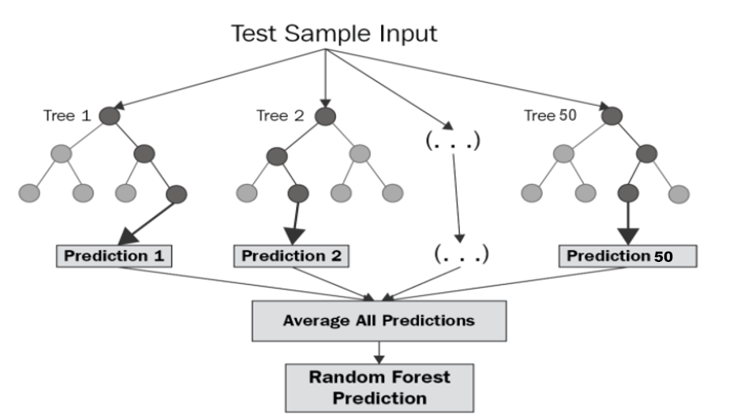
MODULE 2 : MODEL BUILDING
Random Forest Regression :
Random forest (RF) is a collection of multiple decision trees that have variable hyper-parameters and are trained using varying subsets of data.
In our project,we are going to take crop and location as input, and based on it, we will predict the value of N, P, and K.
First, we will divide our dataset into training and test datasets, where the training dataset is 80% of the original data and the rest 20% is test data.
Then we will create three different random forests of size 50 (decision tree) for each N, P, and K and outputs the mean of the classes as the prediction of all the trees, shown in Table
MACHINE LEARNING BASED NUTRIENT RECOMMENDATION SYSTEM FOR SOIL FERTILISATION

Slide 26
MODULE 2 : MODEL BUILDING
Algorithm : Random Forest Regression
BEGIN :
Step 1 : Split the dataset n=2200 into training and test dataset (Where training set is 80% and test set is 20% that is training set=1,760 and test set=240).
Step 2 : Apply random forest regression to each N, P and K (Nitrogen, Phosphorus & Potassium) value with n_estimators=50 (n_estimators is the number of decision tree).
Step 3 : Train N_label, P_Label and K_Label with the training dataset and dependent variable (Where dependent variable is N for N_Label, P for P_Label and K for K_Label).
Step 4 : Each N_Label, P_Label and K_Label generates a 50 decision tree as an output based on training dataset.
END
MACHINE LEARNING BASED NUTRIENT RECOMMENDATION SYSTEM FOR SOIL FERTILISATION

Slide 27
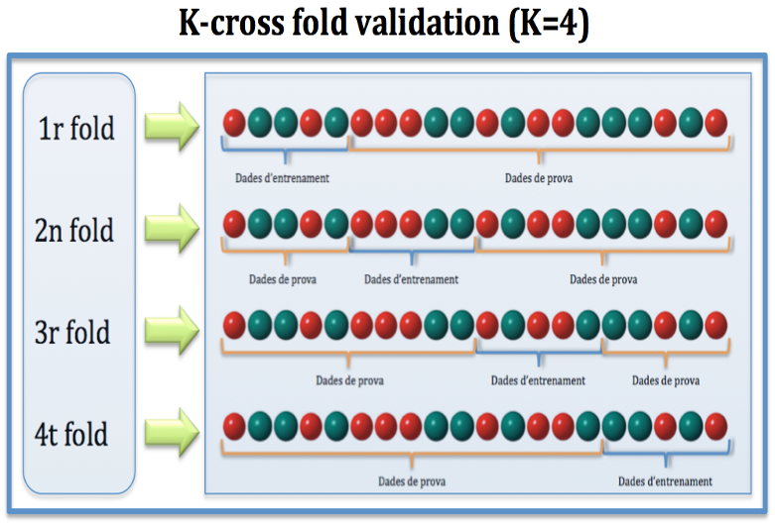
MODULE 2 : MODEL BUILDING
Cross Validation :
Cross-validation is a resampling technique for testing machine learning models on a small set of data.
The algorithm has only one parameter, k, which determines how many groups a given data sample should be divided into. As a result, k-fold cross-validation is a common name for the procedure.
When a specific number for k is supplied, it can be used in place of k in the model's reference, such as k=4 for 4-fold cross-validation.
MACHINE LEARNING BASED NUTRIENT RECOMMENDATION SYSTEM FOR SOIL FERTILISATION

Slide 28


MODULE 3 : BUILD A WEBPAGE
MACHINE LEARNING BASED NUTRIENT RECOMMENDATION SYSTEM FOR SOIL FERTILISATION

Slide 29

RESULT
Eco-Fertilization, a user-friendly system, has been implemented in the form of a website to provide cross-platform functionality and suggest appropriate timings and amount of nutrients required for an inputed crop with a heavy rainfall alert system.
MACHINE LEARNING BASED NUTRIENT RECOMMENDATION SYSTEM FOR SOIL FERTILISATION

Slide 30


OUTPUT
Input Form
Details filled using the drop-down menu
MACHINE LEARNING BASED NUTRIENT RECOMMENDATION SYSTEM FOR SOIL FERTILISATION

Slide 31

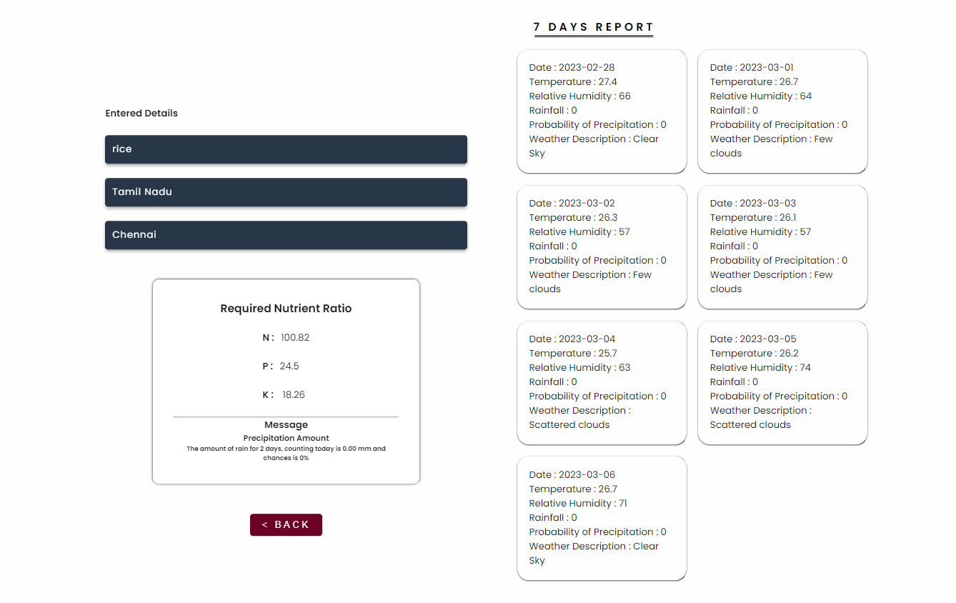
OUTPUT
Applying Algorithm to input details
Output with seven days of weather forecasts & alerts/messages
MACHINE LEARNING BASED NUTRIENT RECOMMENDATION SYSTEM FOR SOIL FERTILISATION

Slide 32

FUTURE SCOPE
The proposed system provides a helping hand to our farmers. It gives information about the use and quantity of nutrients required by the crops. There is scope for improvement in the system by providing user interface in the native language, so that the user can operate the system easily if he or she is unfamiliar with the English language. In addition, speech recognition systems can be added to handle illiterate users.
MACHINE LEARNING BASED NUTRIENT RECOMMENDATION SYSTEM FOR SOIL FERTILISATION

Slide 33

CONCLUSION
The proposed system is able to achieve 92% of accuracy, which is quite good for any predictive model. It provides information about the use and the amount of nutrients required by the crops for satisfactory crop growth and production with respect to weather conditions. It provides weather alerts and messages. Alerts are displayed in the output of this application in case of bad weather conditions. The accuracy can be improved further with development in technologies.
MACHINE LEARNING BASED NUTRIENT RECOMMENDATION SYSTEM FOR SOIL FERTILISATION

Slide 34
References
[1] Krutika Hampannavar,Vijay Bhajantri,Shashikumar G. Totad , “Prediction of Crop Fertilizer Consumption,” Fourth International Conference on Computing Communication Control and Automation (ICCUBEA), 2018, PP. 1-5
[2] G. Prabakaran,D. Vaithiyanathan, Madhavi Ganesan , “Fuzzy decision support system for improving the crop productivity and efficient use of fertilizers ,” Computers and Electronics in Agriculture, vol-150, 2018, PP. 88-97
[3] Shital Bhojani,Nirav Bhatt, “Data Mining Techniques for Crop Yield Prediction,” Computers and Electronics in Agriculture, vol-6, 2018, PP. 357-358
[4] Yulong Yin, Hao Ying,Huifang Zheng ,Qingsong Zhang ,Yanfang Xue,Zhenling Cui , “Estimation of NPK requirements for rice production in diverse Chinese environments under optimal fertilization rates ,” Agricultural and Forest Meteorology, vol-279, 2019, PP. 1-6
[5] Laura J.T. Hess,Eve-Lyn S. Hinckley,G. Philip Robertson,Pamela A. Matson , “Rainfall intensification increases nitrate leaching from tilled but not no-till cropping systems in the U.S. Midwest ,” Agriculture, Ecosystems & Environment, vol-290, 2020, PP. 1-10
[6] Potnuru Sai Nishant,Pinapa Sai Venkat,Bollu Lakshmi Avinash,B. Jabber , “Crop Yield Prediction Based on Indian Agriculture using Machine Learning,” 2020 International Conference for Emerging Technology (INCET), 2020, PP. 1-4
[7] Tony Yang,Kadambot H.M. ,Siddique,Kui Liu , “Cropping systems in agriculture and their impact on soil health ,” Global Ecology and Conservation, vol-23, year, PP. 1-13
[8] János Kátai,Ágnes Oláh Zsuposné,Magdolna Tállai,Tarek Alshaal, “Would fertilization history render the soil microbial communities and their activities more resistant to rainfall fluctuations? ,” Ecotoxicology and Environmental Safety, vol-201, 2020, PP. 1-11
[9] Usman Ahmed,Jerry Chun-Wei Lin, Gautam Srivastava,Youcef Djenouri , “A nutrient recommendation system for soil fertilization based on Evolutionary Computation,” Computers and Electronics in Agriculture, vol-189, 2021, PP. 1-7
[10] A.Hussein , Diogenes L. Antille , Shreevatsa Kodur , GuangnanChen,Jeff N.Tullberg , “Controlled traffic farming effects on productivity of grain sorghum, rainfall and fertiliser nitrogen use efficiency,” Journal of Agriculture and Food Research, vol-3, 2021, PP. 1-17
[11] Zujiao Shi, Donghua Liu, Miao Liu, Muhammad Bilal Hafeez, Pengfei Wen, Xiaoli Wang, Rui Wang, Xudong Zhang, Jun Li , “Optimized fertilizer recommendation method for nitrate residue control in a wheat–maize double cropping system in dryland farming ,” Field Crops Research , vol-271, 2021, PP. 1-10
MACHINE LEARNING BASED NUTRIENT RECOMMENDATION SYSTEM FOR SOIL FERTILISATION

Slide 35
References
[12] Janmejay Pant, R.P. Pant, Manoj Kumar Singh, Devesh Pratap Singh, Himanshu Pant , “Analysis of agricultural crop yield prediction using statistical techniques of machine learning ,” Materials Today: Proceedings, vol-46, 2021, PP. 1-10
[13] Benny Antony , “Prediction of the production of crops with respect to rainfall.,” Environmental Research, vol-202, 2021, PP. 1-5
[14] Akash Manish Lad, K. Mani Bharathi, B. Akash Saravanan, R. Karthik, “Factors affecting agriculture and estimation of crop yield using supervised learning algorithms ,” Materials Today: Proceedings,, 2022, PP. 1-10
[15] Raves Akhtar, Shabbir Ahmad Sofi, “Precision agriculture using IoT data analytics and machine learning,” Journal of King Saud University - Computer and Information Sciences, 2021, PP. 1-17
[16] Fang-binQIAOJi-kunHUANG, “Farmers' risk preference and fertilizer use,” Journal of Integrative Agriculture,vol-20, PP. 1987-1995
[17] Saheed Garnaik, Prasanna Kumar Samant, Mitali Mandal, Tushar Ranjan Mohanty, Sanat Kumar Dwibedi, Ranjan Kumar Patra, Kiran Kumar Mohapatra, R.H. Wanjari, Debadatta Sethi, Dipaka Ranjan Sena, Tek Bahadur Sapkota, Jagmohan Nayak, Sridhar Patra, Chiter Mal Parihar, Hari Sankar Nayak, “Untangling the effect of soil quality on rice productivity under a 16-years long-term fertilizer experiment using conditional random forest,” Computers and Electronics in Agriculture, vol-197,2022, PP. 1-10
[18] Rubby Aworka, Lontsi Saadio Cedric, Wilfried Yves Hamilton Adoni, Jérémie Thouakesseh Zoueu, Franck Kalala Mutombo, Charles Lebon Mberi Kimpolo, Tarik Nahhal, Moez Krichen, “Agricultural decision system based on advanced machine learning models for yield prediction: Case of East African countries,” Smart Agricultural Technology, vol-3, 2022, PP. 1-9
[19] Senthil Kumar Swami Durai, Mary Divya Shamili, “Smart farming using Machine Learning and Deep Learning techniques,” Decision Analytics Journal, vol-2, 2022, PP. 1-30
[20] M.S. Suchithra, Maya L. Pai, “Improving the prediction accuracy of soil nutrient classification by optimizing extreme learning machine parameters,” Information Processing in Agriculture, vol-7, 2022, PP. 1-11
MACHINE LEARNING BASED NUTRIENT RECOMMENDATION SYSTEM FOR SOIL FERTILISATION

Slide 36

THANK YOU

